Slide 1

INTERNET OF THINGS
Chapter5: IP as the IoT Network Layer
Dr. Nagegowda K S
Department of Computer Science & Engineering

Slide 2
INTERNET OF THINGS
Agenda
The Business Case for IP
The Need for Optimization
Optimizing IP for IoT
Profiles and Compliances

Slide 3
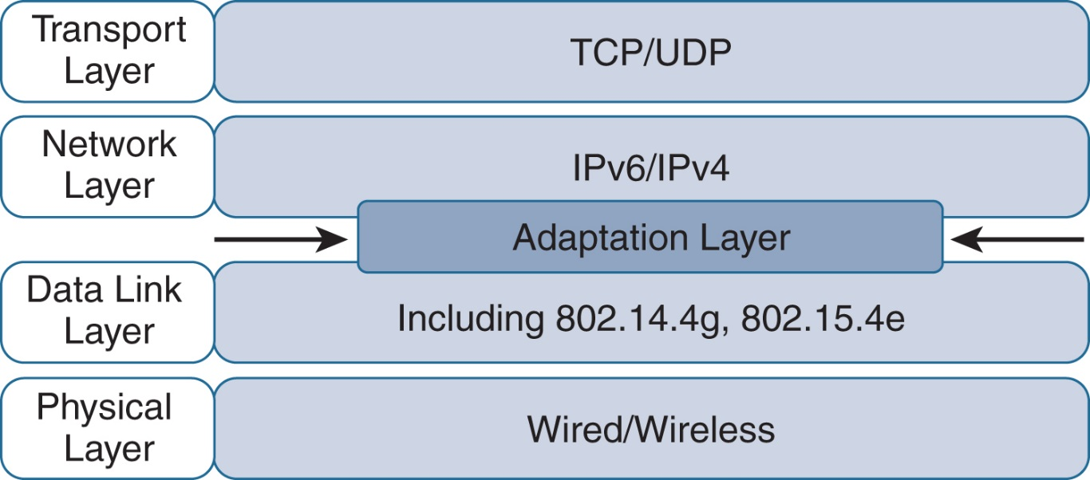
INTERNET OF THINGS
Optimizing IP for IoT
Figure - Optimizing IP for IoT Using an Adaptation Layer

Slide 4
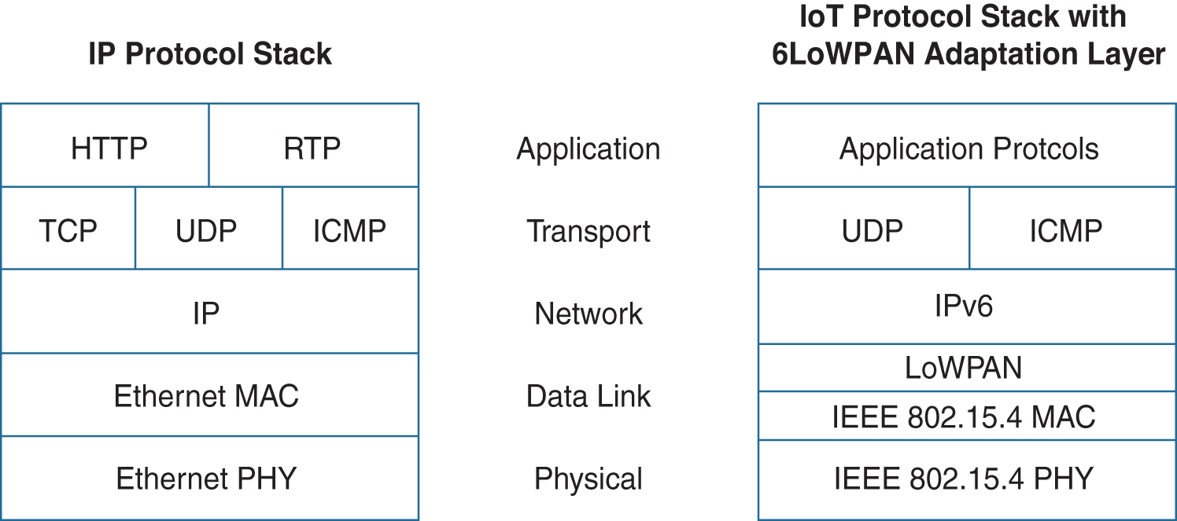
INTERNET OF THINGS
Optimizing IP for IoT
Figure - Comparison of an IoT Protocol Stack Utilizin 6LoWPAN and an IP Protocol Stack

Slide 5
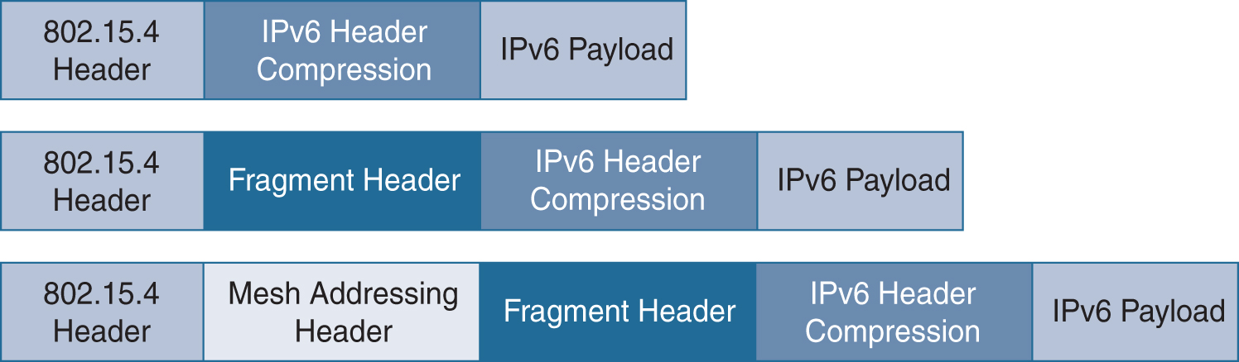
INTERNET OF THINGS
Optimizing IP for IoT
Figure - 6LoWPAN Header Stacks

Slide 6
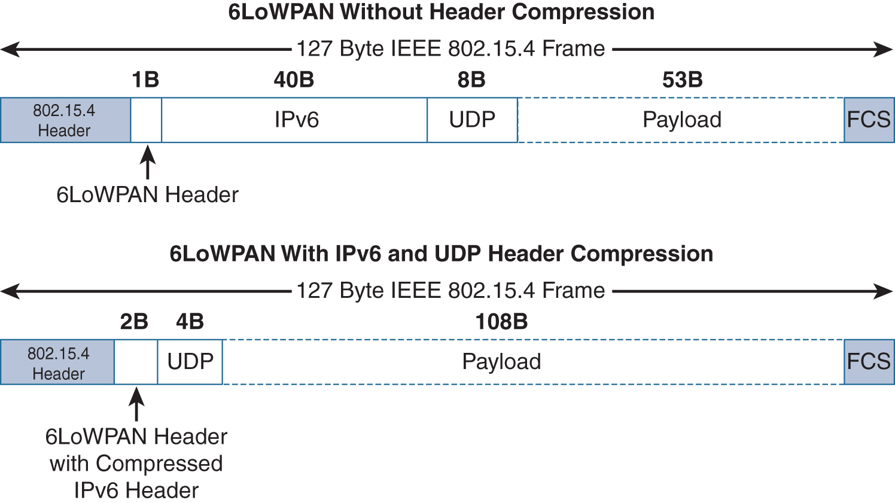
INTERNET OF THINGS
Optimizing IP for IoT-Header Compression
Figure - 6LoWPAN Header Compression

Slide 7
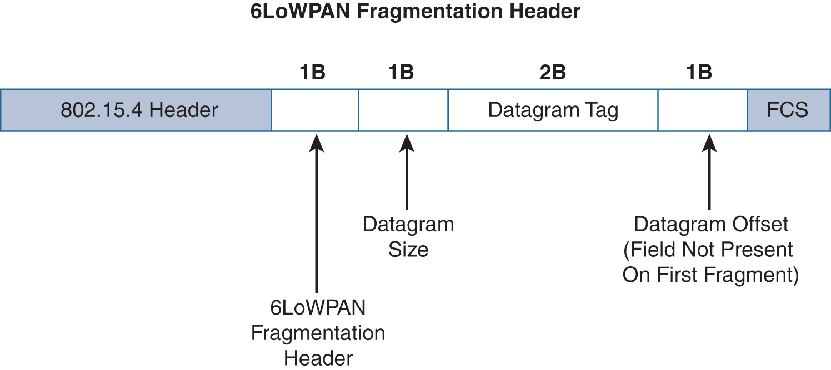
INTERNET OF THINGS
Optimizing IP for IoT- Fragmentation
Figure - 6LoWPAN Fragmentation Header

Slide 8
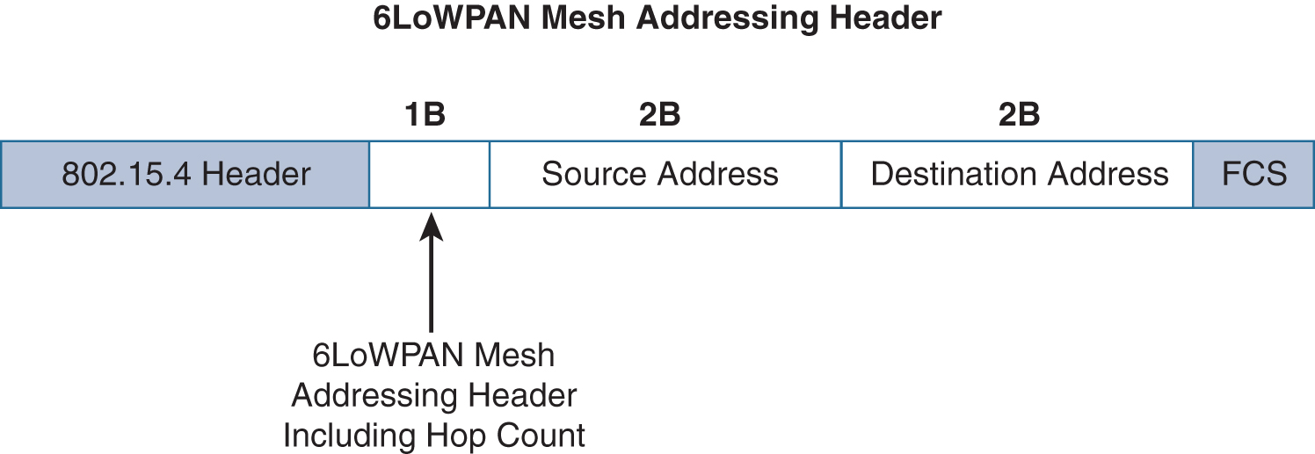
INTERNET OF THINGS
Optimizing IP for IoT- Mesh addressing

Slide 9
INTERNET OF THINGS
Optimizing IP for IoT- 6Lo Working Group
IPv6 over Bluetooth Low Energy
Transmission of IPv6 packets over near-field communication
IPv6 over 802.11ah
Transmission of IPv6 packets over DECT Ultra Low Energy
Transmission of IPv6 packets on WIA-PA (Wireless Networks for Industrial Automation–Process Automation)
Transmission of IPv6 over Master Slave/Token Passing (MS/TP)

Slide 10
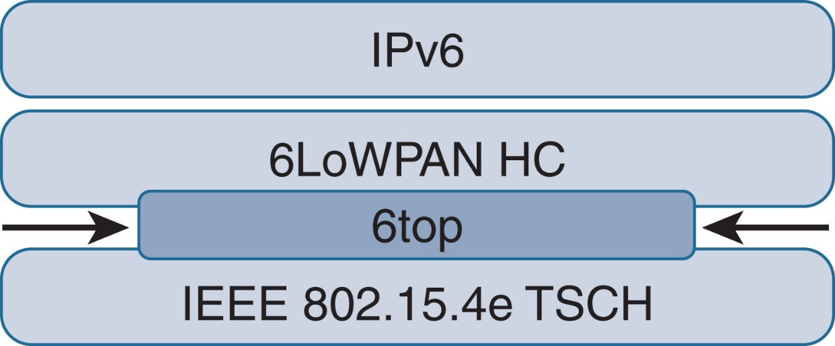
INTERNET OF THINGS
Optimizing IP for IoT- 6TiSCH
Figure - Location of 6TiSCH’s 6top Sublayer

Slide 11
INTERNET OF THINGS
Optimizing IP for IoT- 6TiSCH
Schedule Management mechanisms:
Static scheduling
Neighbour-to-neighbour scheduling
Remote monitoring and scheduling management
Hop-by-hop scheduling

Slide 12
INTERNET OF THINGS
Optimizing IP for IoT- 6TiSCH
6TiSCH forwarding Model:
Track Forwarding
Fragment forwarding
IPv6 forwarding

Slide 13

THANK YOU
Dr. Nagegowda K S
Department of Computer Science & Engineering
nagegowda@pes.edu

